Slide 1


Microsoft AL Application Lifecycle

Slide 2
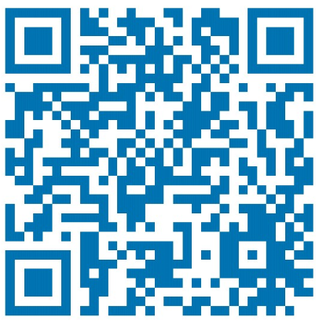




Competence Team DevTech
Profil
Never stop learning!
Technology Evangelist
Microsoft AL – Business Central – Azure – Cognitive Services – PowerShell – Docker – Git – DevOps – .NET – C# – JavaScript – SQL – LINQ – …
@MMe2K
Teams-Channel
Microsoft AL
Michael Megel Business Development @ cc Dresden

Slide 3
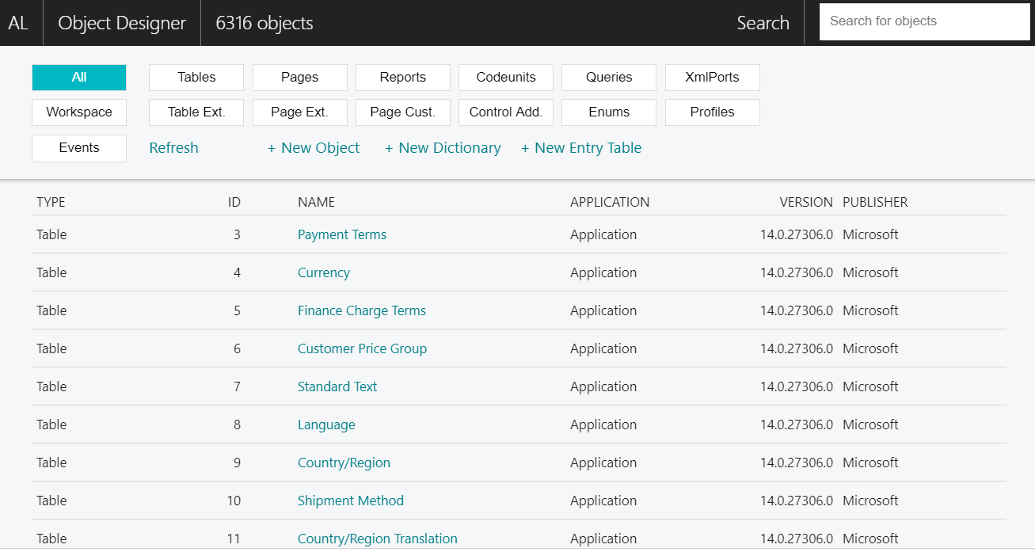

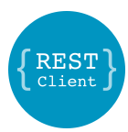
VS Code Useful Extensions
AL Formatter
AL Code Outline
AL Object Designer
CRS AL Language Extension
JSON5 syntax
AL Runner
REST Client
VS Live Share
Visual Studio Live Share Extension Pack
Visual Studio IntelliCode

Slide 4

Application Lifecycle
Overview
Publish
Install
Uninstall
Unpublish
Reinstall and Upgrade
Application Dependencies
Hand On

Slide 5

Microsoft AL App Lifecycle – Installation

Slide 6
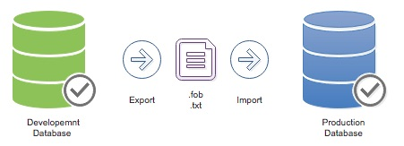
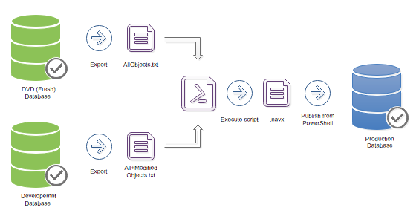
Business Central Installation Process
[Sources]
Dmitry Katson - Demystifying installation process for Business Central Apps
Old classic customizations "installation" approach
Export sources
Merge sources into new version
Import sources
Extensions 1.0
Export Original sources
create Delta-Files by PowerShell (Delta = Modified – Original)
Create App (.navx) with PowerShell (Manifest)
Publish App

Slide 7
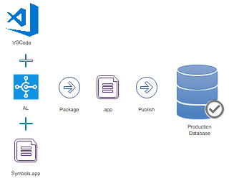
Business Central Installation Process
[Sources]
Dmitry Katson - Demystifying installation process for Business Central Apps
Extensions 2.0
Download Symbols
Compile App (local Sources) ➔ .app
Optional sign the App with certificate
Publish the App

Slide 8
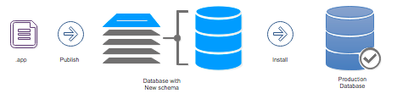
Business Central Installation Process
[Sources]
Dmitry Katson - Demystifying installation process for Business Central Apps
Installation of Extensions 2.0
Download Symbols
Compile App (local Sources) ➔ .app
Optional sign the App with certificate
Publish the App

Slide 9
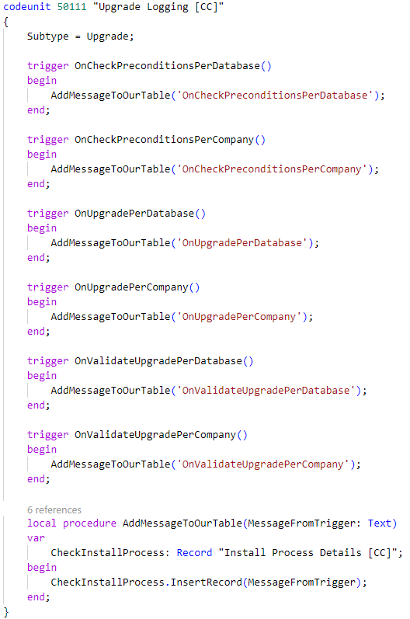
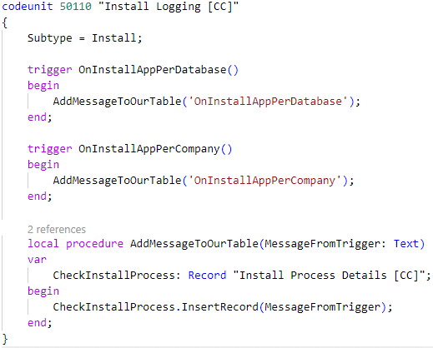
Business Central Install and Upgrade Codeunits
Install Codeunit Subtype=Install;
An extension is installed for the very first time.
An uninstalled version is installed again.
Upgrade Codeunit Subtype=Upgrade;
“An upgrade codeunit includes AL methods for synchronizing changes to a table definition in an application with the business data table in SQL Server and migrating existing data.“

Slide 10
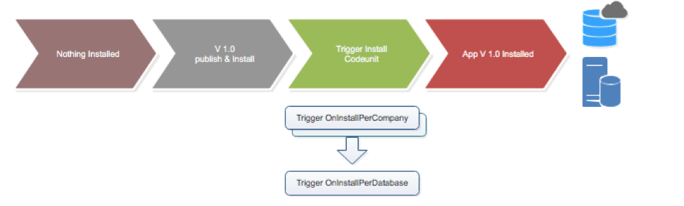
Business Central Install App – First Time
Container Sandbox (used for Local Development)
Online Sandbox
Online Business Central Production Tenant
VSCode > AL:Publish without debugging (Ctrl+F5)
PSScript> Publish-NavContainerApp `
-containerName $containername `
-appFile $appfilename `
-install `
-skipVerification `
-sync `
-tenant $tenant
VSCode > AL:Publish without debugging (Ctrl+F5)
Web client > Extensions Page >Upload .app file

Slide 11

Hands On

Slide 12
Business Central Hands-On
Prerequisites
Connect to your Workshop VM → use Instructions on your Workshop Boarding Pass
Use the “Starter-01” project of your Workshop Material for “Application Lifecycle”
Hand On - Tasks
Create an Install Codeunit
Create an Upgrade Codeunit
Install the App and check the results

Slide 13
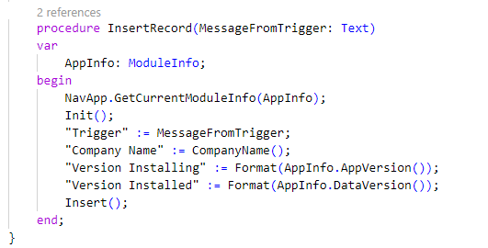
Business Central Hands-On
Use Table “Install Process Details [CC]” … ID: “50110”
Complete the method “InsertRecord”
Store the message
Get and Store version information
Get and Store company information
Use “ModuleInfo” and “AppInfo”
Don’t forget the Timestamp ☺

Slide 14
Business Central Hands-On
Codeunit “Install Logging [CC]” … ID: “50110”
Create the Codeunit
Subtype: Install
Implement all triggers and Call the prepared method on table “Install Process Details [CC]”

Slide 15
Business Central Hands-On
Codeunit “Upgrade Logging [CC]” … ID: “50111”
Create the Codeunit
Subtype: Upgrade
Implement all triggers and Call the prepared method on table “Install Process Details [CC]”

Slide 16
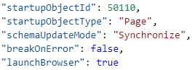
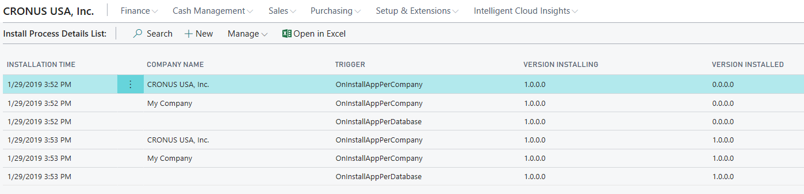
Business Central Hands-On
Check your “launch.json“
Update Mode: Synchronize
Install the App in your Development Environment (several times) ☺
VS Code > [Ctrl + F5]
Check the Result in Web Client
Open Page „Install Process Details List“
Check the Information
Switch Update Mode to Recreate and run again
Check what happens!

Slide 17
Microsoft AL App Lifecycle – Upgrade

Slide 18
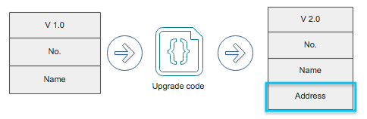
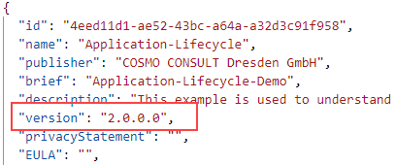
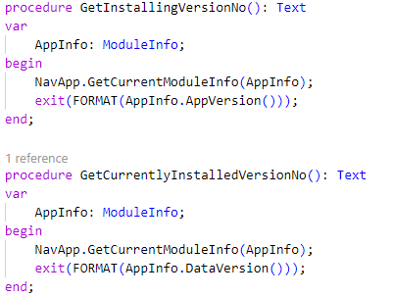
Business Central Upgrading an App
[Sources]
Dmitry Katson - Demystifying upgrade process for Business Central Apps
Preparation
What app version is already installed?
What app version is installing?
Reasons for Upgrades
Improved or new functionality
changes on tables
Correction of data
How to Upgrade?
Increase the version number in “app.json”
Add an Upgrade Codeunit to handle some changes in Triggers
Check the Versions numbers in the Upgrade Process

Slide 19
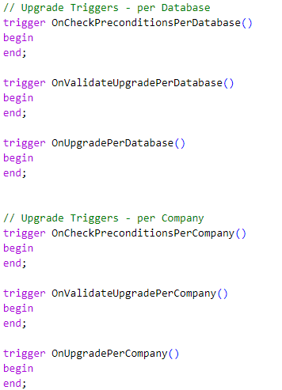
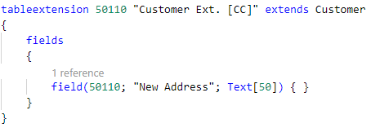
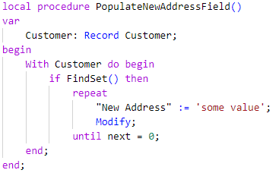
Business Central Upgrading an App
[Sources]
Dmitry Katson - Demystifying upgrade process for Business Central Apps
Changes in our App
Table Extension with additional fields
Upgrade Codeunit – Triggers
Check Pre Conditions
Validate Upgrade
Execute the Upgrade
Prepare the Upgrade

Slide 20
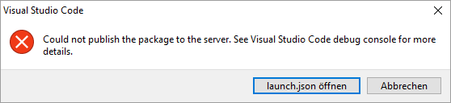
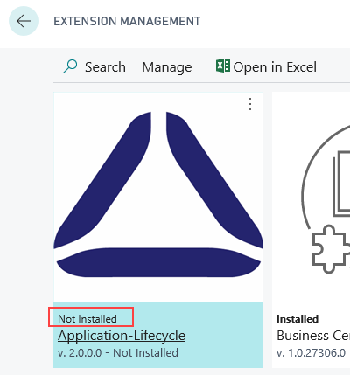
Business Central Upgrading an App
[Sources]
Dmitry Katson - Demystifying upgrade process for Business Central Apps
Deploying the Upgrade / Running from VS Code Upgrade
[Ctrl + F5] or [F5] → Error
BUT … App is Published & Not Installed
Upgrade by PowerShell
or use NAVContainerHelper on the local VM!!! … BUT you need Access to the Container!!!
The request for path /NAV/dev/apps?SchemaUpdateMode=synchronize failed with code 422. Reason: Cannot install the extension Application-Lifecycle by COSMO CONSULT Dresden GmbH 1.0.0.1 for the tenant default because an earlier version was already installed. Run Start-NAVAppDataUpgrade to upgrade the extension.
PSScript> Start-NavContainerAppDataUpgrade ` -containerName $containername `
-appName $appname

Slide 21
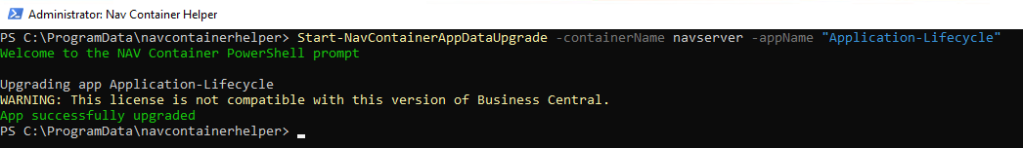
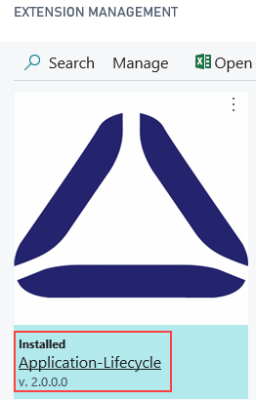
Business Central Upgrading an App
[Sources]
Dmitry Katson - Demystifying upgrade process for Business Central Apps
Data Upgrade is executed – invoked by PowerShell

Slide 22
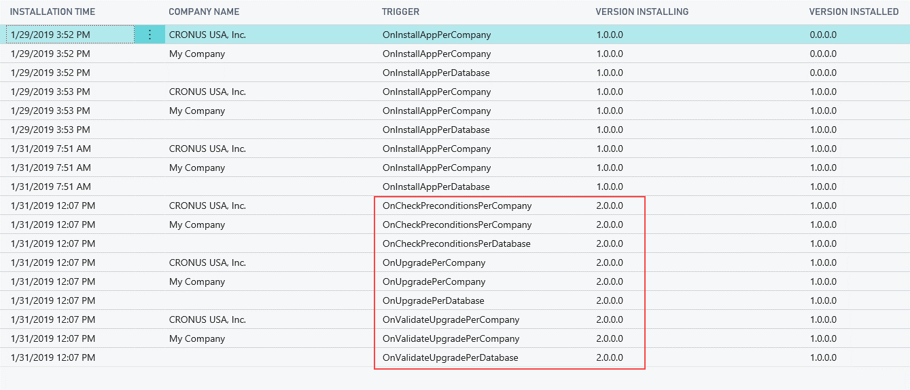
Business Central Upgrading an App
[Sources]
Dmitry Katson - Demystifying upgrade process for Business Central Apps

Slide 23
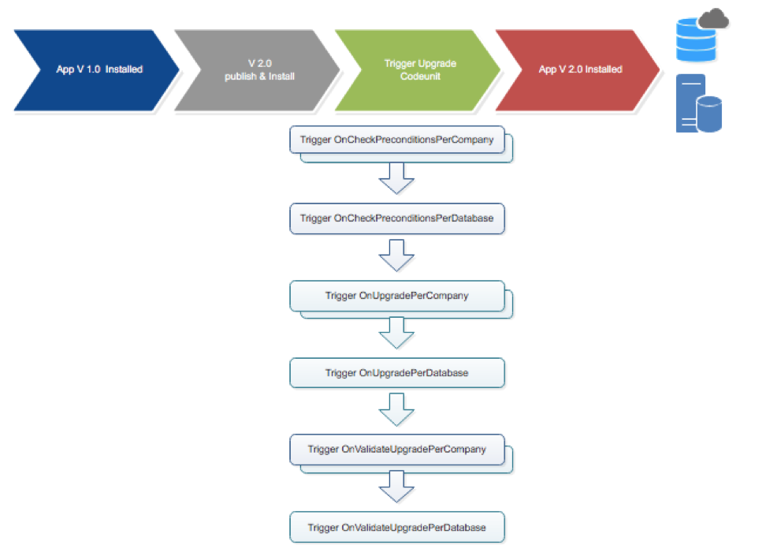
Business Central Upgrading an App
Upgrade codeunit was triggered …because we publish our app for the second time …because with increased version id.
Install codeunit was not triggered. … because we changed the version of our app

Slide 24
Hands On

Slide 25
Business Central Hands-On
Prerequisites
Connect to your Workshop VM → use Instructions on your Workshop Boarding Pass
Use the “Starter-02” project of your Workshop Material for “Application Lifecycle”
Hand On - Tasks
Create an Upgrade Codeunit for your example
Try to Install the App
Run the “AppDataUpgrade”
Check the results

Slide 26
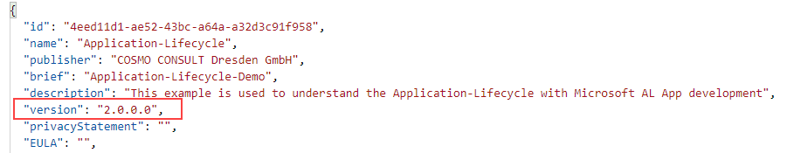
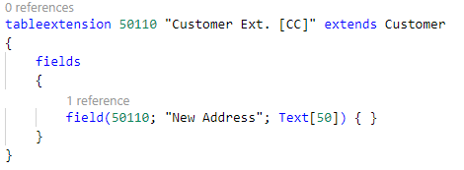
Business Central Hands-On | Prepare the Upgrade
Open your App Manifest
Change the Version to “2.0.0.0”
Check the Table Extension
“Customer Ext. [CC]” with ID “50110”
Extend table “Customer”
Check field “New Address” (ID 50110) of type Text[50]

Slide 27
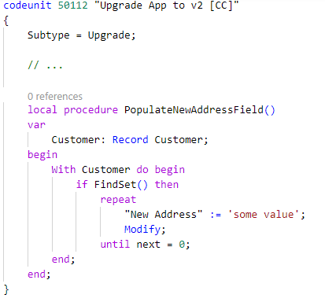
Business Central Hands-On | Prepare the Upgrade
Create an Upgrade Codeunit
Name “Upgrade App to v2 [CC]” with ID “50112”
Subtype: Upgrade
Add code and initialize the new field “New Address” on table “Customer”

Slide 28
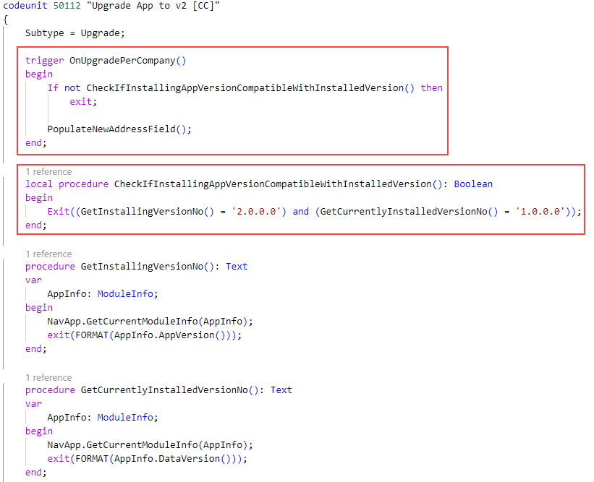
Business Central Hands-On | Prepare the Upgrade
Handle the Upgrade
Implement the right Trigger
Check the Version change from: 1.0.0.0 ➔ 2.0.0.0

Slide 29
Business Central Hands-On | Check and Run the Upgrade
Open Page “Extension Management”
Check the current Version of your App
Publish the App from VS Code [Ctrl + F5]
An error should appear and Check the error message
Open Page “Extension Management”
Check the current Version of your App
Connect to your VM (Remote Desktop)
Open the PowerShell (NAVContainerHelper)
Start the App Data Upgrade
Check the Result and the called triggers in Page “Install Process Details List”
PSScript> Start-NavContainerAppDataUpgrade ` -containerName $containername `
-appName $appname

Slide 30
Microsoft AL App Lifecycle – Re-Install an App

Slide 31
Business Central Re-Install an App
3 Way to Re-Install an App
Re-Install an App by Development → VS-Code
Re-Install an App by Uninstall & Install → PowerShell
Re-Install an App by Uninstall, Unpublish, Publish and Install → PowerShell
Unpublish and Upgrade your App

Slide 32
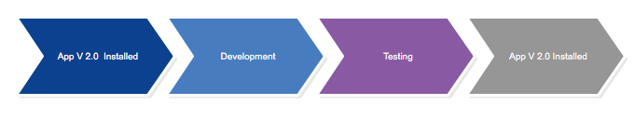
Business Central Re-Install an App 1
[Sources]
Dmitry Katson - Demystifying re-installation process for Business Central Apps. Without uninstall
Overriding the App during development
Container Sandbox (used for Local Development)
Current App overrides the existing App – because Synchronization isn’t necessary
VSCode > AL:Publish without debugging (Ctrl+F5)

Slide 33
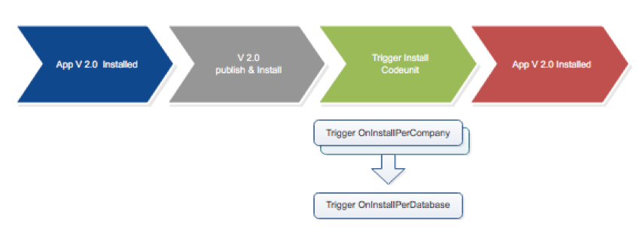
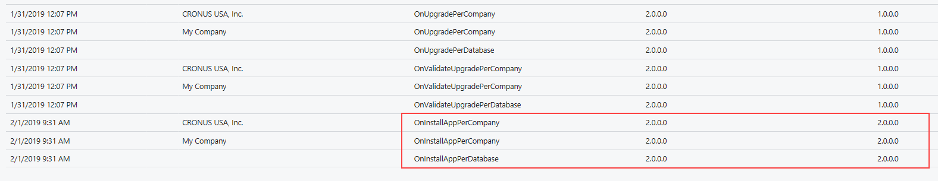
Business Central Re-Install an App 1
[Sources]
Dmitry Katson - Demystifying re-installation process for Business Central Apps. Without uninstall
Summary
Upgrade codeunit was not triggered
Install codeunit was triggered

Slide 34
Business Central Re-Install an App 2
[Sources]
Dmitry Katson - Demystifying re-installation process for Business Central Apps. With uninstall
Uninstall the App with PowerShell and NAVContainerHelper
Re-Install the App by VS Code or PowerShell
PSScript> UnInstall-NavContainerApp ` -containerName $containername `
-tenant $tenant `
-appName $appname
VSCode > AL:Publish without debugging (Ctrl+F5)
PSScript> Install-NavContainerApp ` -containerName $containername `
-tenant $tenant `
-appName $appname

Slide 35
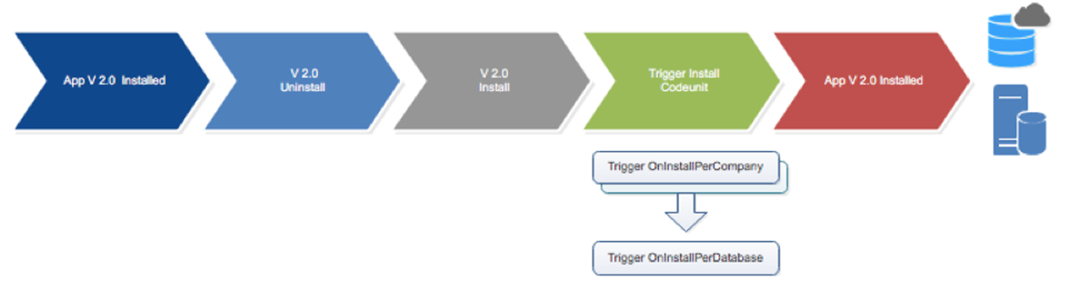
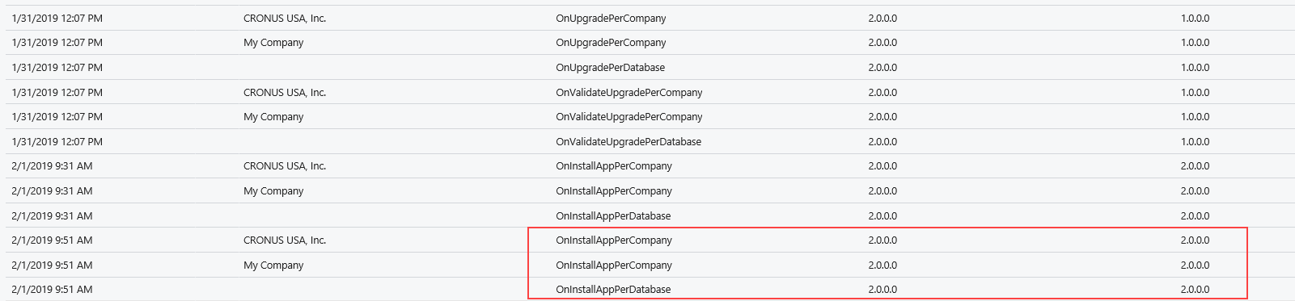
Business Central Re-Install an App 2
[Sources]
Dmitry Katson - Demystifying re-installation process for Business Central Apps. With uninstall
Summary
Upgrade codeunit was not triggered
Install codeunit was triggered

Slide 36
Business Central Re-Install an App 3
[Sources]
Dmitry Katson - Demystifying re-installation process for Business Central Apps. With uninstall
Unpublish the current App with PowerShell
Re-Publish the App from VS Code [Ctrl + F5]
PSScript> UnPublish-NavContainerApp ` -containerName $containername `
-tenant $tenant `
-appName $appname `
-unInstall `
-version $version `
-tenant $tenant

Slide 37
Business Central Re-Install an App 3
[Sources]
Dmitry Katson - Demystifying re-installation process for Business Central Apps. With uninstall
Publish the current App with VS Code [Ctrl + F5]

Slide 38
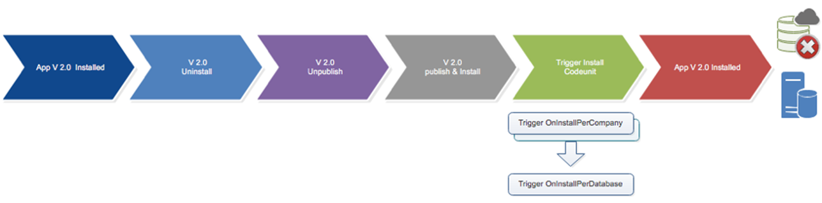
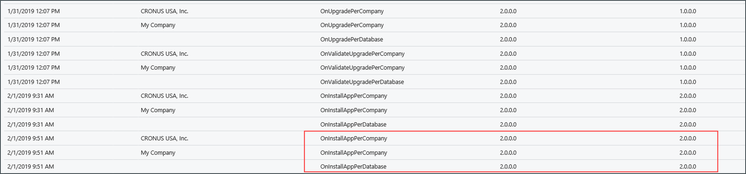
Business Central Re-Install an App 3
[Sources]
Dmitry Katson - Demystifying re-installation process for Business Central Apps. With uninstall
Summary
Upgrade codeunit was not triggered
Install codeunit was triggered

Slide 39
Business Central Upgrade with Un-Publish
[Sources]
Dmitry Katson - Demystifying re-installation process for Business Central Apps. With uninstall
Preparation
New App-Version 3.0.0.0 in app.json
Unpublish the current App with PowerShell
PSScript> UnPublish-NavContainerApp ` -containerName $containername `
-tenant $tenant `
-appName $appname `
-unInstall `
-version $version `
-tenant $tenant

Slide 40

Business Central Upgrade with Un-Publish
[Sources]
Dmitry Katson - Demystifying installation process for Business Central Apps. Conclusion
Re-Compile the App 3.0.0.0
Publish App 3.0.0.0 with VS Code [Ctrl + F5]

Slide 41
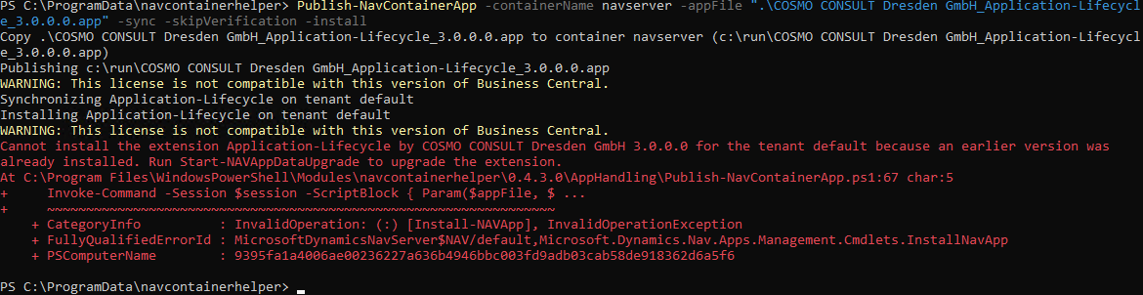
Business Central Upgrade with Un-Publish
[Sources]
Dmitry Katson - Demystifying installation process for Business Central Apps. Conclusion
Publish App 3.0.0.0 with PowerShell
PSScript> Publish-NavContainerApp ` -containerName $containername `
-appFile $appfilename `
-install `
-skipVerification `
-sync `
-tenant $tenant

Slide 42
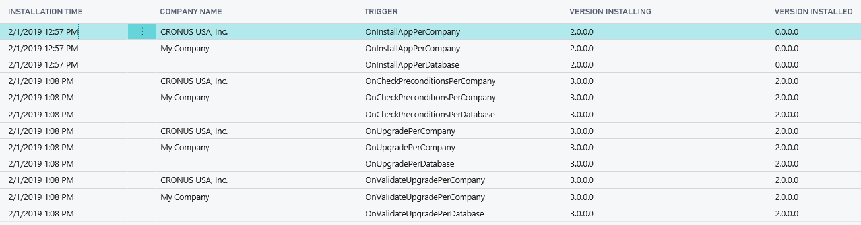
Business Central Upgrade with Un-Publish
[Sources]
Dmitry Katson - Demystifying installation process for Business Central Apps. Conclusion
Run NAV App Data Upgrade with PowerShell for App 3.0.0.0
PSScript> Start-NavContainerAppDataUpgrade ` -containerName $containername `
-appName $appname

Slide 43
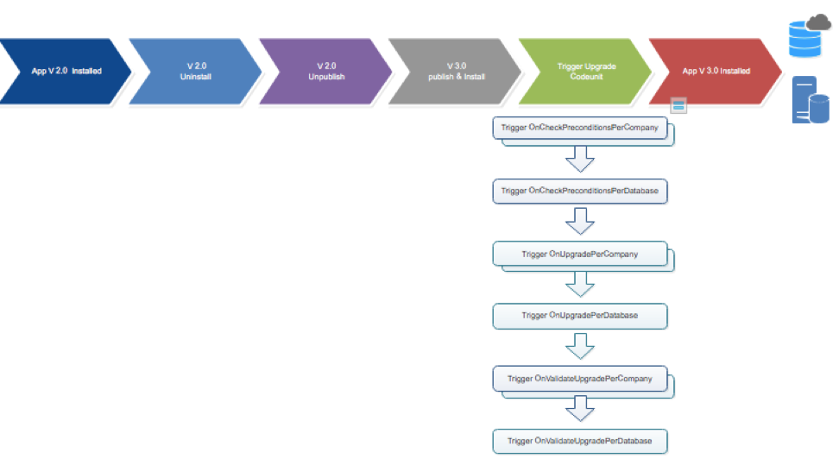
Business Central Upgrade with Un-Publish
[Sources]
Dmitry Katson - Demystifying installation process for Business Central Apps. Conclusion
Summary
Upgrade codeunit was triggered
Install codeunit was triggered

Slide 44
Business Central Application Lifecycle
[Sources]
Dmitry Katson - Demystifying installation process for Business Central Apps. Conclusion
Process | Previous App version is installed | New App version changed | Upgrade Codeunit triggers | Install Codeunit triggers | Supported in Local Sandbox | Supported in Online Sandbox | Supported in Online Production
Publish & Install | - | Yes | - | Yes | Yes | Yes | Yes
Upgrade App | Yes | Yes | Yes | - | Yes | Yes | Yes
Re-Install | Yes | - | - | Yes | Yes | Yes | -
Uninstall & Install | Yes | - | - | Yes | Yes | Yes | Yes
Unpublish & Re-install | Yes | - | - | Yes | Yes | Yes | -
Unpublish & Upgrade | Yes | Yes | Yes | - | Yes | Yes | Yes

Slide 45
Hands On

Slide 46
Business Central Hands-On
Prerequisites
Connect to your Workshop VM → use Instructions on your Workshop Boarding Pass
Use the “Starter-03” project of your Workshop Material for “Application Lifecycle”
Hand On - Tasks
Re-Install an App by Development with VS-Code
Re-Install an App by Uninstall & Install with PowerShell
Re-Install an App by Uninstall, Unpublish, Publish and Install
Unpublish and upgrade your App

Slide 47
Business Central Hands-On | Re-Install an App by Development with VS-Code
Open your Solution
Check the App Version “2.0.0.0”
Compile and Deploy
Check the Result
Use Page “Install Process Details List”

Slide 48
Business Central Hands-On | Re-Install an App by Uninstall & Install with PowerShell
Open your Solution
Check the App Version “2.0.0.0”
Uninstall your App with PowerShell
Install your App with PowerShell
Check the Result
Use Page “Install Process Details List”

Slide 49
Business Central Hands-On | Re-Install an App by Uninstall, Unpublish, Publish and Install
Open your Solution
Check the App Version “2.0.0.0”
Unpublish your App with PowerShell
Install your App with VS Code [Ctrl + F5]
Check the Result
Use Page “Install Process Details List”

Slide 50
Business Central Hands-On | Unpublish and upgrade your App
Open your Solution
Check the initial App Version “2.0.0.0”
Unpublish your App with PowerShell
Change the Version
App.json
Deploy your App 3.0.0.0 with VS Code [Ctrl + F5]
Upgrade NAV App Data with PowerShell
Check the Result

Slide 51
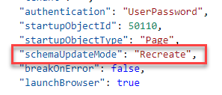
Business Central Hands-On | Unpublish and upgrade your App
Repeat with Powershell
Rest App Version to 2.0.0.0
Re-Deploy … by modifying your launch.json and recreate your App on NST
Check the Result
Unpublish your App with PowerShell
Change the Version
App.json
Deploy your App 3.0.0.0 with PowerShell
Copy file to VM
Upgrade NAV App Data with PowerShell

Slide 52
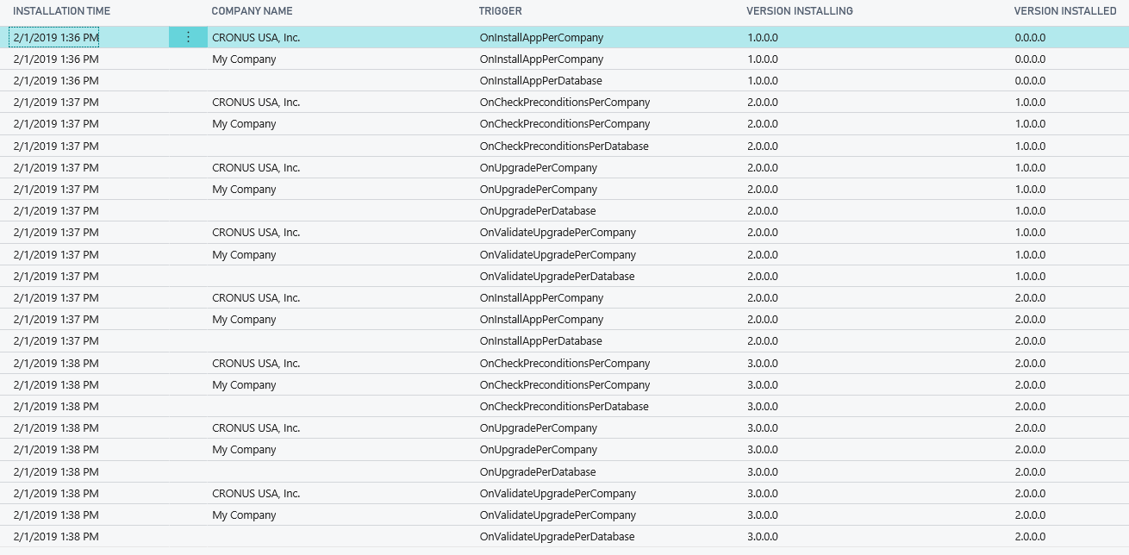
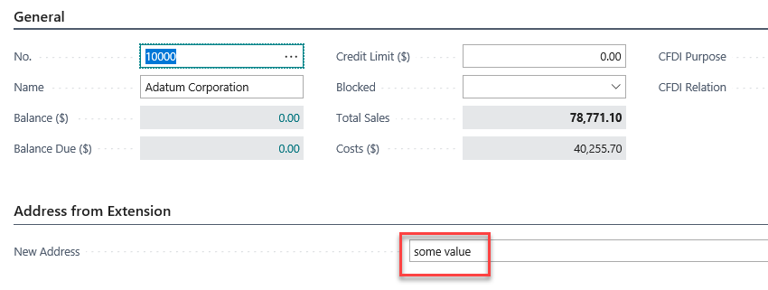
Business Central Hands-On | Unpublish and upgrade your App
Check the Results
Installation Details
Customer Card “The Added Data”

Slide 53
Microsoft AL Application Dependencies

Slide 54
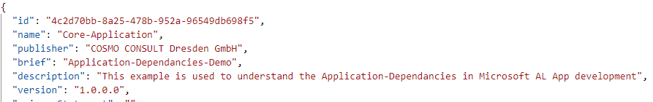
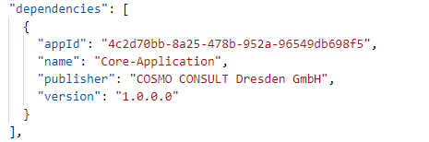
Business Central Application Dependencies
2 Applications
Core Application
Local Application
Local App depends on Core App
Dependencies stored in app.json of Local App
AppID, Name, Publisher, Version
Symbols
Core is part of Local App symbols

Slide 55
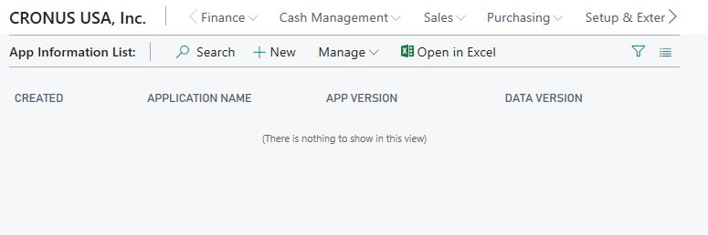
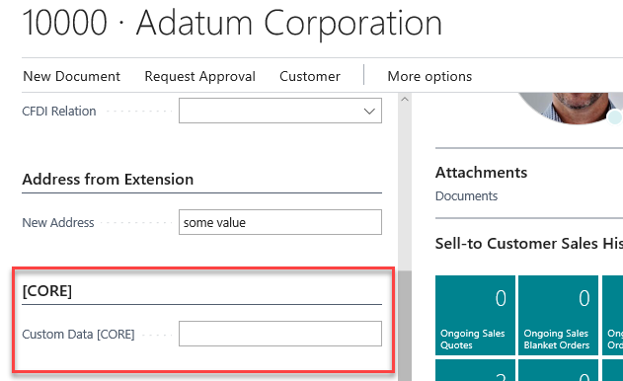
Business Central Application Dependencies | Core Application 1.0.0.0
Table
“App Information [CORE]”
Page
“App Information List [CORE]“
Table Extension
“Customer Ext. [CORE]“ extends “Customer “
Page Extension
“Customer Ext. [CORE]“ extends “Customer Card“

Slide 56
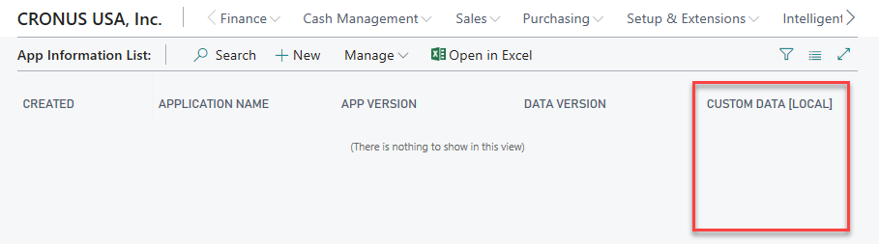
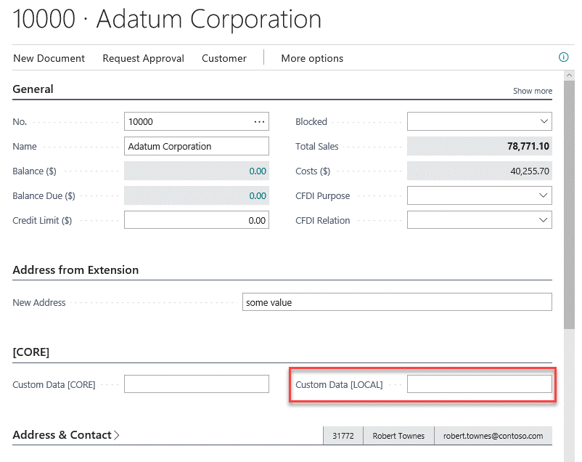
Business Central Application Dependencies | Local Application 1.0.0.0
Table Extension
“App Information [LOCAL]” extends “App Information [CORE]”
Page Extension
“App Information List [LOCAL]” extends “App Information List [CORE]”
Table Extension
“Customer Ext. [LOCAL]“ extends “Customer“
Page Extension
“Customer Ext. [LOCAL]“ extends “Customer Card“

Slide 57
Hands On

Slide 58
Business Central Hands-On
Prerequisites
Connect to your Workshop VM → use Instructions on your Workshop Boarding Pass
Use the “Starter-04” project of your Workshop Material for “Application Lifecycle”
Hand On - Tasks
Create the CORE App with Table, Table Extension, Page and Page Extension
Create the LOCAL App with Table Extensions and Page Extensions

Slide 59
Business Central Hands-On | CORE Application
Open “…04/01_Core_App” from “Starter”
Check app.json
ID, Version, …
Connect to your Business Central and download the symbols
Tasks
Check the CORE App with Table, Table Extension, Page and Page Extension
Compile and Publish the App
Check in Page “Extension Management”

Slide 60
Business Central Hands-On | LOCAL Application
Open “…04/02_Local_App” from “Starter”
Check and Complete the app.json
ID, Version, …
Add a dependency to the CORE App (copy information from app.json)
Download Symbols
Hand On - Tasks
Extend Table “Customer“ and add a Field “Custom Data [LOCAL]“ (Text 50)
Extend Page “Customer Card“ and display the added Field
Extend Table “App Information [CORE]“ and add a Field “Custom Data [LOCAL]“ (Text 50)
Extend Page “App Information List [CORE]“ and display the added Field
Deploy the Local App and check the Results

Slide 61
Business Central Hands-On | Change the CORE Application
Prerequisites
Add some Data in “App Information List [CORE]“ and extended “Customer Card“
Tasks
Add a new Field to Table “App Information [CORE]“, and include it into “App Information List [CORE]“
Add a new Field to Table “Customer Ext. [CORE]“, and include it into “Customer Card Ext. [CORE]“
Write an Upgrade Codeunit
Upgrade the CORE App to Version 2.0.0.0 without any lost of existing data ☺

Slide 62


Application Lifecycle
Competence Team DevTech
Channel Microsoft AL

